Slide 1
Hackathon’25 : Solve Rubik’s Cube

Slide 2
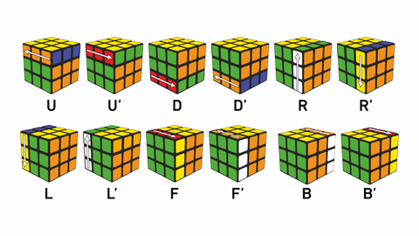
Solve Rubik’s Cube
Overview
Participants are challenged to design and implement an algorithm that can solve a standard 3x3 Rubik’s Cube from any scrambled state. The solution must mimic the real-world logic of solving a cube through a sequence of valid moves.
What We’re Looking For : 🔍
Problem-Solving Approach
How do you break down the problem?
How do you model the cube’s state and transitions?
Use of Data Structures
How do you represent the cube internally (e.g., arrays, trees, graphs)?
Use of efficient structures to track states and operations.
State Prediction Logic
Ability to track and predict cube state after each move.
Design of a move engine to simulate rotations and track permutations.
Algorithm Efficiency
How fast can your solution reach the solved state?
Complexity (time and space) of your algorithm.
Bonus Evaluation Areas
Creativity in solution design.
Visual simulation or cube UI (optional but Wow factor).
Scalability for different cube sizes (2x2, 4x4, etc.) : Optional
Deliverables:
Working algorithm (code)
Brief walkthrough/presentation of your approach
Output example(s) from your solver
It’s Not Just a Puzzle - It’s a Test of Mind, Math, and Moves!

Slide 3
Solve Rubik’s Cube
Problem-Solving Approach
Automated Cube Solving Pipeline – Accepts any valid Rubik’s Cube scramble and returns a guaranteed solving sequence.
Robust Cube State Recognition – Infers face identities from sticker colors with fallback to majority color detection for reliability.
Efficient Data Structure Usage – Cube state stored as a 2D array of Sticker objects per face, easily mapped to a 1D 54-character facelet string for solver compatibility.
Two-Phase Solve Logic – Converts cube state to standardized facelet string, processes it via the Kociemba two-phase algorithm for optimal moves.
Verification Layer – Applies computed solution to a virtual cube to ensure the final state is solved before returning the result.
Seamless UI Integration – Backend computation results are rendered in a clean, interactive web interface.
It’s Not Just a Puzzle - It’s a Test of Mind, Math, and Moves!

Slide 4
Solve Rubik’s Cube
Algorithm / Idea
State Encoding → Represent cube state as a 54-character string in URFDLB order.
Kociemba’s Two-Phase Algorithm →
Phase 1: Reduce cube to a restricted subgroup (orientation + edge slice solved).
Phase 2: Solve remaining subgroup to the solved state.
Move Application & Simulation – Use pycuber to apply scramble and solution sequences virtually.
Output Mapping – Return both move list and color-mapped cube state for visual display.
It’s Not Just a Puzzle - It’s a Test of Mind, Math, and Moves!

Slide 5
Solve Rubik’s Cube
Uniqueness of the Idea
End-to-End Web Solution – Combines professional cube-solving logic with a minimalistic, elegant web UI for real-time visualization.
Dual-Language Tech Stack – Bridges Python’s algorithmic strengths with React + Bootstrap for a responsive frontend.
User-Friendly Experience – No cube-solving knowledge needed; instantly get a verified solution and visual confirmation.
Extensible Design – Architecture allows adding features like step-by-step animation, camera-based cube scanning, and cloud deployment.
Educational Value – Demonstrates real-world application of algorithms, data structures, and full-stack integration.
It’s Not Just a Puzzle - It’s a Test of Mind, Math, and Moves!

Slide 6
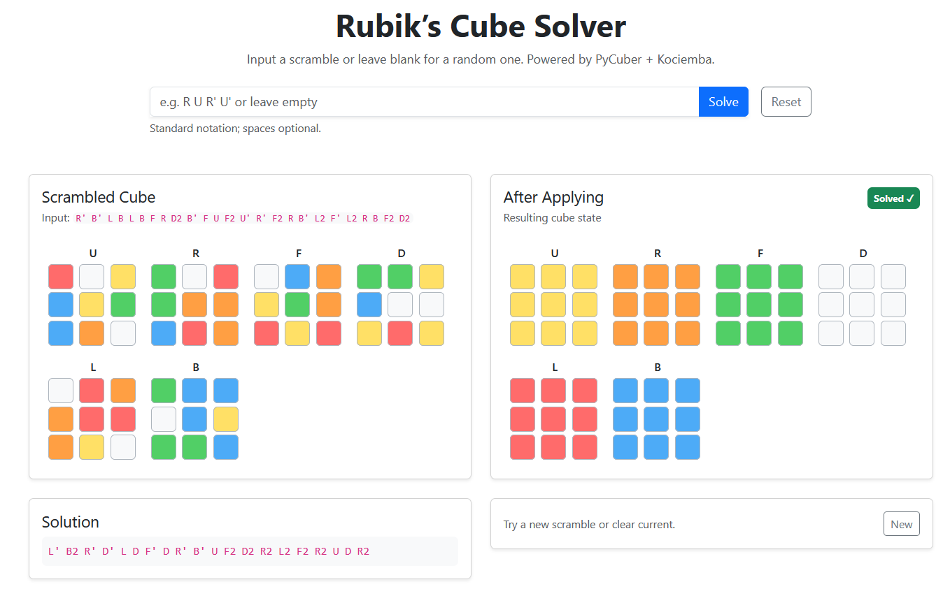
Solve Rubik’s Cube
Output:
Github Code:
https://github.com/krishnatejaswi2005/Rubik-s-3x3-Cube-Solver
It’s Not Just a Puzzle - It’s a Test of Mind, Math, and Moves!

